Slide 1
Introduction
This document will show you how to Use Accessibility checker within word
Notes:
Word 2010 comes with a new accessibility checker which allows you to check for problems in your document. This checker allows you to scan your document, identifying any problems and than suggesting a simple fix to the problem.

Slide 2
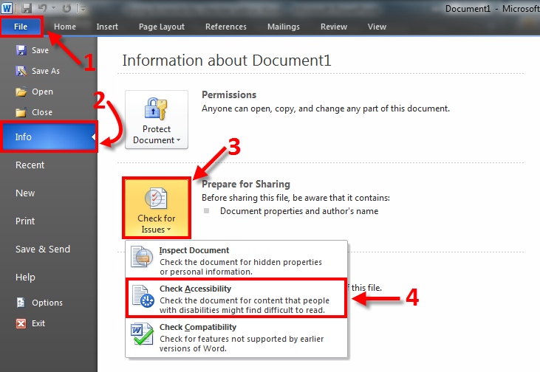
Notes:
Once you are in done working on a Word document and would like to do an accessibility check, you must:
Click on File
Click on Info
Click on Check for Issues
Click on Check Accessibility

Slide 3
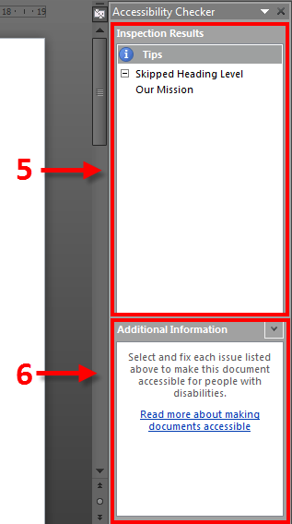
Notes:
The Accessibility Checker dialog box will appear on the right hand side of your word document after the checker scans your document for errors.
It will provide you feedback in the following fashion:
5. Inspection Results along with Tips on how to mane the proper repairs will be posted in the dialog box.
6. Additional Information will be posted Directly under Inspections and Tips

Slide 4
If you experience any problems in using Accessibly Checker within Word, Please don’t hesitate to contact King’s ITS at:
helpdesk@kings.uwo.ca

