Slide 1
Introduction
This document will show you how to Separate Book Files in Adobe Acrobat XI Pro
Notes:
This task is completed on downloaded pdf book files directly from the publisher and/or AERO. Most digital text book files will come in one large file that includes the entire textbook; however, they MUST to be separated into smaller sized files thereby making them easier to load and view in any assistive technology program.

Slide 2
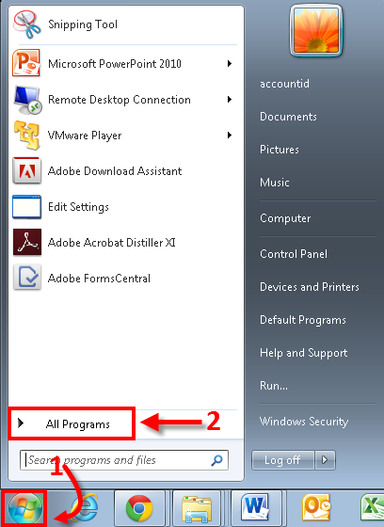
Notes:
You will first have to open up Adobe Acrobat XI Pro. To locate Adobe Acrobat XI Pro, please proceed with the following steps:
Click on the Start Menu Icon located on the bottom left of the screen
Click on All Programs

Slide 3
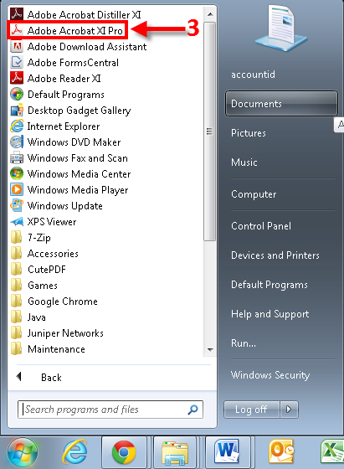
Notes:
Under All Programs, you will see a list of programs and folders
3. Locate and click on Adobe Acrobat XI Pro

Slide 4
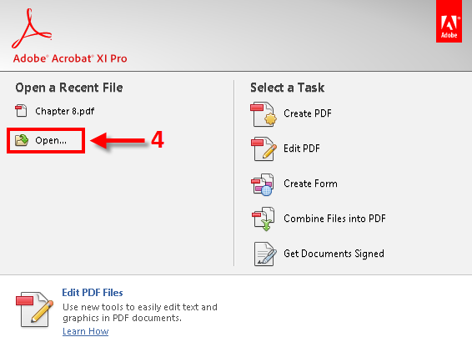
Notes:
Once Adobe Acrobat XI Pro is open, you will want to open up the PDF file of the book you would like to separate:
4. Click on Open…

Slide 5
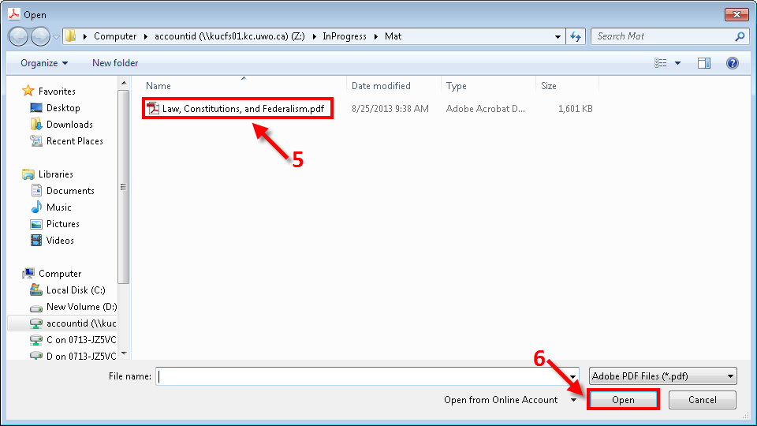
Notes:
You will then want to locate the PDF file which you would like to separate. For this Example, we will be using an electronic PDF book called “Law, Constitution, and Ferderalism.pdf”
5. Click on the file which you would like to use
6. Click Open

Slide 6
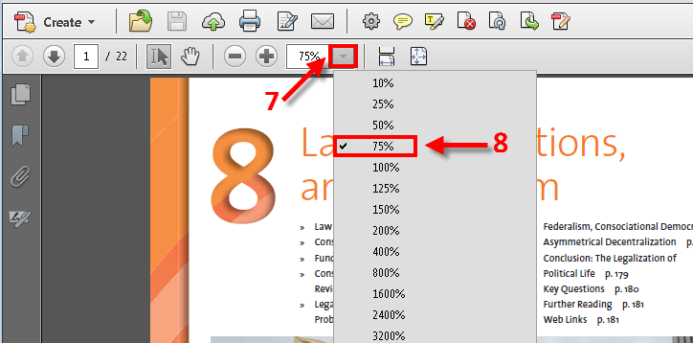
Notes:
Once you have opened the file, you will want to adjust the percentage of the viewed page to 75%.
Note: This is done in order to able to look at an entire page onscreen at one single time.
7. Click on the Downward tab (arrow looking tab)
8. Click on 75%

Slide 7
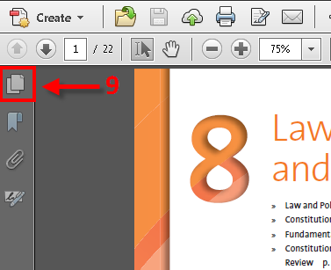
Notes:
9. Click on the Page Thumbnail button located on the upper left side of the page.
This will display the Page Thumbnails for this specific file.

Slide 8
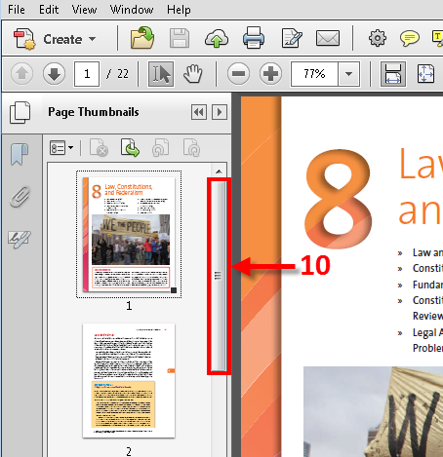
Notes:
*Note: Each page will now be displayed.
10. You may use the Scroll Bar as indicated above to navigate and view all the pages in your document.

Slide 9
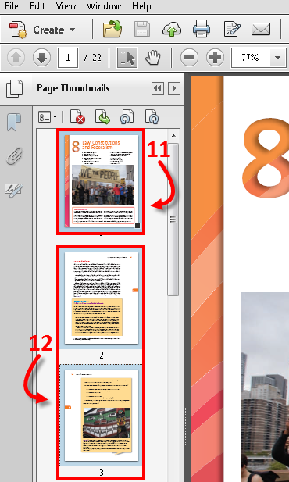
Notes:
11. Left-click on the first Page Thumbnail you wish to select
*Note: You will know that you have selected the Thumbnail as the Page Thumbnail pane will now be highlighted Blue
Once the Thumbnail is highlighted blue:
12. Simultaneously hold-down the Shift ↑ Key while pressing the downwards Arrow (↓). This will begin to group your specifically highlighted pages together.

Slide 10
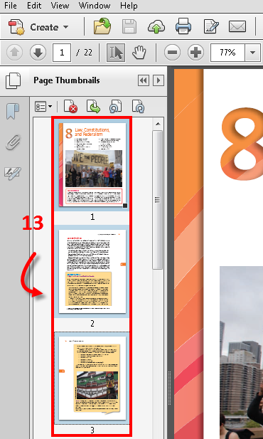
Notes:
13. Once you are satisfied with the pages you wish to include in a selection, simply release your finger. (Pages 1-3 were selected for this example)

Slide 11
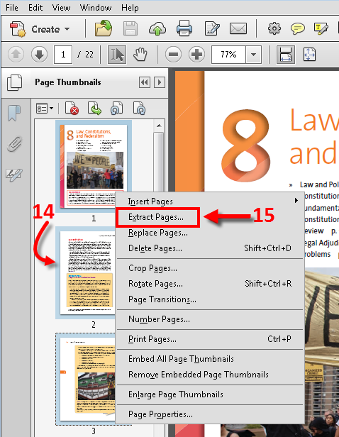
Notes:
14. With your mouse, Right-click anywhere in the highlighted Blue area
15. Select Extract Pages…

Slide 12
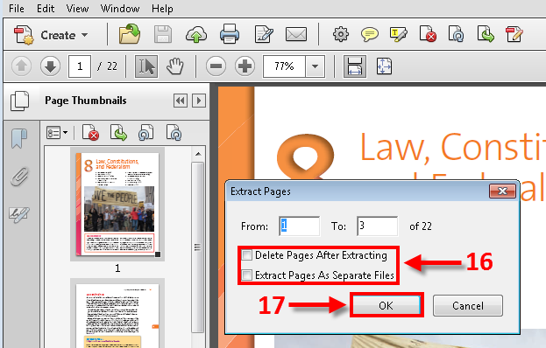
Notes:
An Extract Pages window will pop up:
16. Leave the 2 check boxes unchecked (empty)
17. Click OK

Slide 13
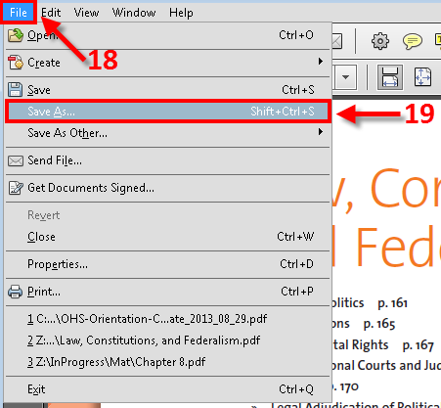
Notes:
The extracted pages will now open in a separate Adobe window. You are now ready to save the extracted file.
18. Click on File located at the top left corner of your adobe document window
19. Click Save As…

Slide 14
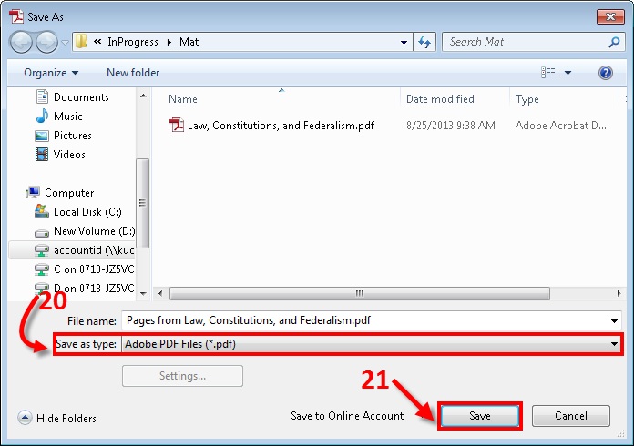
Notes:
20. Ensure that the file type is save as Adobe PDF Files (*.pdf)
21. Click Save
You have now separated your first file of the book. Close this newly opened file window and continue with the rest of the entire book file, repeating the same process.

Slide 15
If you experience any difficulties Separating Book Files with Acrobat Adobe XI Pro , please don’t hesitate to email the ITS department at:
helpdesk@kings.uwo.ca

