Slide 1
Introduction
This document will show you how to Create an Accessible PowerPoint Presentation
Notes:
The following document was created using excerpts from WebAIM’s guide on PowerPoint Accessibility

Slide 2
Table of Contents
Creating Accessible PowerPoint Documents………........................................2
Step 1 – Provide Alternative Text for Images……………......................3
Step 2 – Fix Reading Order…………………………………...........................5
Test Reading Order………………………………………....................6
Change Reading Order…………………………………………………….7
Step 3 – Include Captions for any Audio or Video………………………….8
Step 4 – Data Tables……………………………………………………………………..9
Step 5 – Bullets…………………………………………………………………………….10
Step 6 – Add Hyperlinks……………………………………………………………….11
Step 7 – Accessibility……………………………………………………………………14
Step 8 – Save as PDF…………………………………………………………………….18

Slide 3
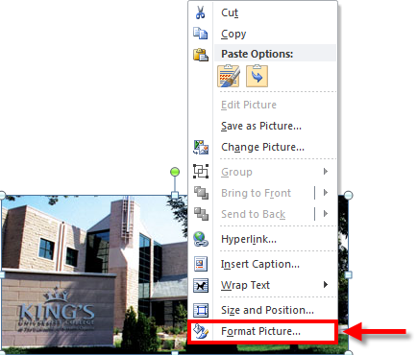
Notes:
Step 1 – Providing Alternative Text for Images
PowerPoint presentations usually contain images. These images should be given alternative text (alt text), to be read by screen readers such as JAWS. This alt txt will remain intact if the document is saved as a Word document or a PDF. For more information on this topic, visit out AT Accessibility community and see out wiki on Alt Text Best practices
Note: If the image is decorative (like a border or separator line) and carries no meaning, do not enter any alt text – and JAWS will ignore the image. (In Microsoft word, images are never ignored – so always enter alt text in Word)
To add alt text to an image, right-click on the image and select Format Picture

Slide 4
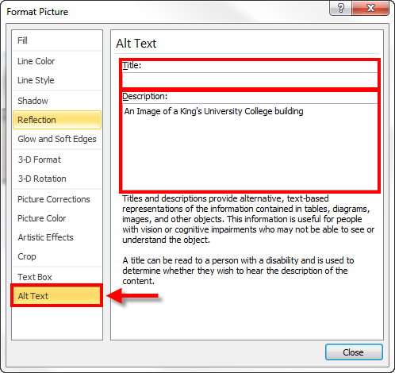
Notes:
The Format Picture window will open. Enter a Description only. Don’t bother to enter a Title – it won’t be read by JAWS during the PowerPoint presentation, and wont be carried forward if converted to a PDF. (In Microsoft Word it’s the opposite – always enter the Title in Word, because the Description won’t be carried forward to a PDF

Slide 5
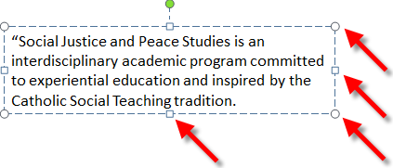
Notes:
Step 2 – Fix Reading Order
A screen reader (like JAWS) will read aloud each object on a slide, in the order in which they were originally placed on the slide, not the order in which they appear in the slide.
Text Reading Order
Make sure to check that all objects on the slide are in a logical reading order. There are a couple of ways to do this:
Check on a black spot in the slide, and then press the Tab Key repeatedly. Each time you press the Tab key, an object will be highlighted (see the image below). Tabbing through the objects will highlight each one in the order that it will be read.

Slide 6
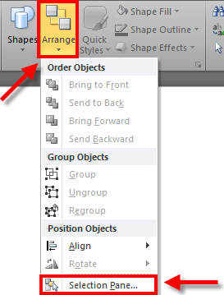
Notes:
OR…
Use the selection Pane (new for PowerPoint 2010). See bellow for details.
Change Reading Order
In previous versions of PowerPoint, the only way to re-order objects on a slide was to open another PowerPoint presentation, copy all the objects over, and copy them back in the proper order.
To check the order in which your slide content will be read back, do the following:
On the home tab, in the Drawing
group, click Arrange and then choose
Selection Pane.

Slide 7
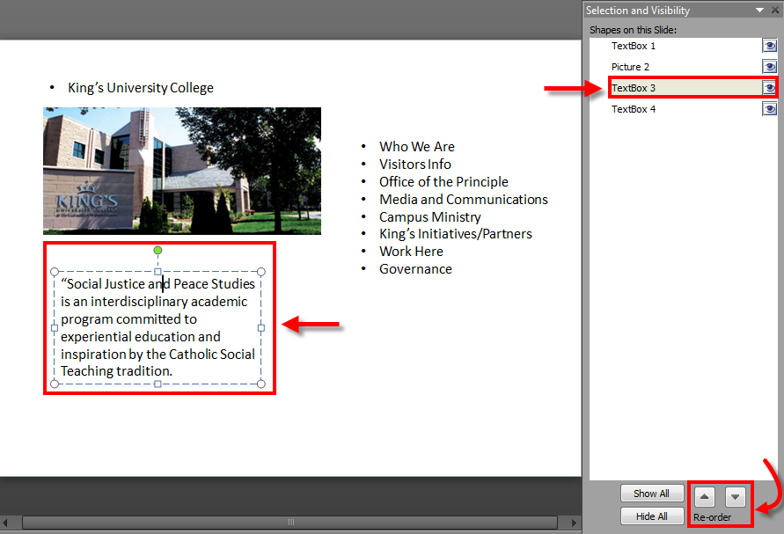
Notes:
2. The Selection Pane lists the object on the slide. Objects will be read back beginning with the bottom list item and ending with the tip list item. Cirrect any out of order items using the Re-order arrows on the bottom of the pane.
Note: the bottom object on the Selection Pane will be read first.

Slide 8
Welcome to King’s University College, My name is David Sylvester, the 8th Principle of King’s University College.
Notes:
Step 3 – Include Captions for any Audio or Video
If your presentation includes audio or video, be sure to include captions or a transcript. Whenever information can’t be made accessible an accessible alternative should be provided.

Slide 9
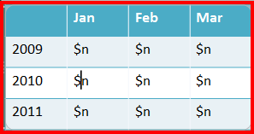
 | Jan | Feb | Mar
2009 | $n | $n | $n
2010 | $n | $n | $n
2011 | $n | $n | $n
Notes:
Step 4 – Data Tables
In HTML, there are ways to define row headings and column headings so that JAWS user can navigate the table more easily. PowerPoint has various themes to make tables look attractive, but it doesn’t tell JAWS which rows or columns are headings. For this reason we recommend that you either:
Keep your data table short so it’s easy to navigate
OR
b) Insert an image of the data table, and add descriptive (but short) alt text to the image.
Jan
Feb
Mar
2009
$n
$n
$n
2010
$n
$n
$n
2011
$n
$n
$n

Slide 10
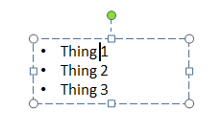
Notes:
Step 5 – Bullets
When creating lists, please click the bullet tool in the Paragraph section. Do no t pimply use dashes or other symbols to represent bullets as they will simply appear as raw text to JAWS. When you use the bullet tool, JAWS can read the bulleted list more clearly, saying “bullet” before each item, and pausing between items.

Slide 11
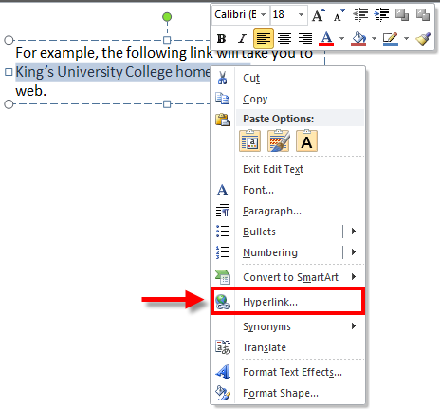
Notes:
Step 6 – Add Hyperlinks
In PowerPoint, immediately after you type a URL (e.g. http://www.kings.uwo.ca) and press Enter, a hyperlink will be automatically created for you, but this is not always meaningful to an assistive technology user. Whenever possible, make a hyperlink by using a work or phrase within the text that will identify where the link is taking you to. For example, the following link will take you to King’s home page on the web.
To turn a word or a phrase into a hyperlink, use the following steps:
1. Highlight the text you want. Right click your mouse and choose the option “Hyperlink”.

Slide 12
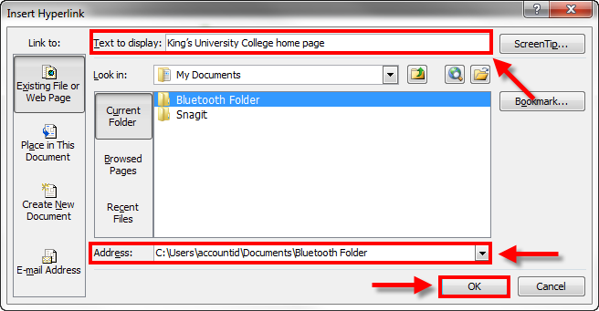
Notes:
2. In the window that will pop-up (see image below), the text you highlighted will be displayed in the “text to display” box. You can then type or cut-and-paste the URL address of the page to be linked to the “Address” box. Then click OK.

Slide 13
Notes:
3. After clicking OK, (you will be able to see an active link (underlines and in blue) as in the example below:

Slide 14
Notes:
Step 7 – Accessibility Checker
PowerPoint 2010 includes an Accessibility Checker that will scan your presentation for problems.
Accessibility checker can only be used on .pptx files, and not on the older .ppt files. If you have a *.ppt file, do a File > Save as Type: PowerPoint Presentation (*.pptx).

Slide 15
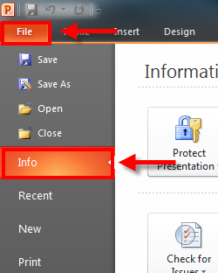
Notes:
To run the Accessibility Checker, Click on File > Info

Slide 16
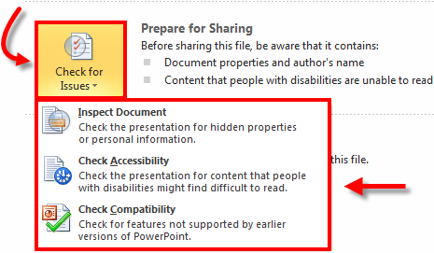
Notes:
Click Check for Issues > Check Accessibility

Slide 17
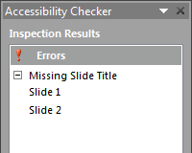
Notes:
Accessibility Checker will report accessibility problems in your document, give you an opportunity to fix them before you publish.

Slide 18
Notes:
Step 8 – Save as PDF
Your presentation is now ready to be converted to a PDF (If you want).
Click File > Save As. In the “Save as Type” drop-down Select “PDF (*.pdf)”. This is a new feature for PowerPoint 2010, and this is the best way to convert your presentation to a PDF.
Next click the Save button, and you’re done – you have created an accessible PDF

Slide 19
If you experience any problems creating Associable PowerPoint Documents, Please don’t hesitate to contact King’s ITS at:
helpdesk@kings.uwo.ca

