Slide 1
Introduction
This document will show you how to Crop Published Files in Adobe Acrobat XI Pro
Notes:
The following task is ONLY completed on downloaded book files that appear similar to the image below. Please have the book folder separated into specific files (i.e. Our example of the 3 separated pages in the How to Separate Book Files Instructional) and saved prior to completing the following task as this will keep the book folder organized, ensuring each file will be viewable for a student.
Note: DO NOT crop the original publisher file, as a whole (publisher original files are ALWAYS kept in their original state, without assistive technology manipulation, cropping, deleting blank pages, etc.).
When a publisher provides a pdf copy of a text book, in some cases, there could be specific publisher markings (or print markings) located around the perimeter of the file. Kurzweil will typically have each file automatically cut-off these publisher markings when it begins to download a file; however we still need to complete this step prior to students receiving their text books as not all students use Kurzweil as an assistive technology program

Slide 2
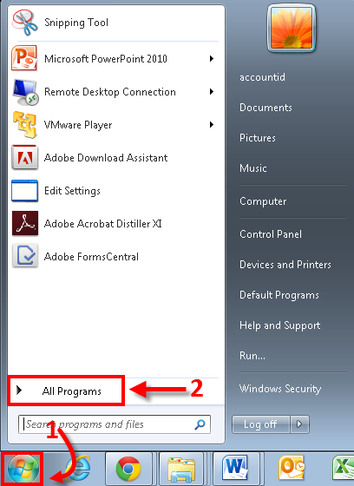
Notes:
You will first have to open up Adobe Acrobat XI Pro. To locate Adobe Acrobat XI Pro, please proceed with the following steps:
Click on the Start Menu Icon located on the bottom left of the screen
Click on All Programs

Slide 3
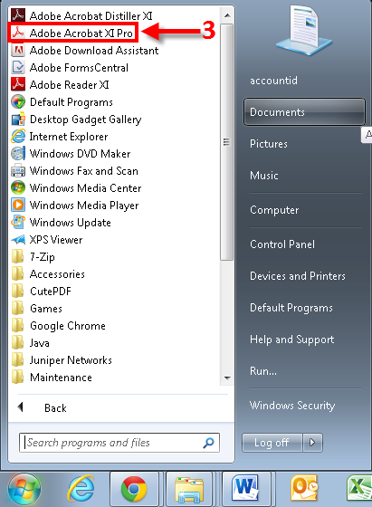
Notes:
Under All Programs, you will see a list of programs and folders
3. Locate and click on Adobe Acrobat XI Pro

Slide 4
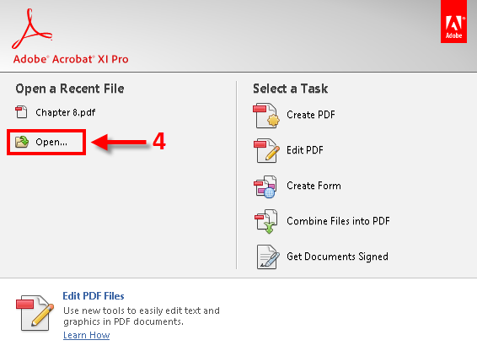
Notes:
Once Adobe Acrobat XI Pro is open, you will want to open up the PDF file of the book you would like to separate:
4. Click on Open…

Slide 5
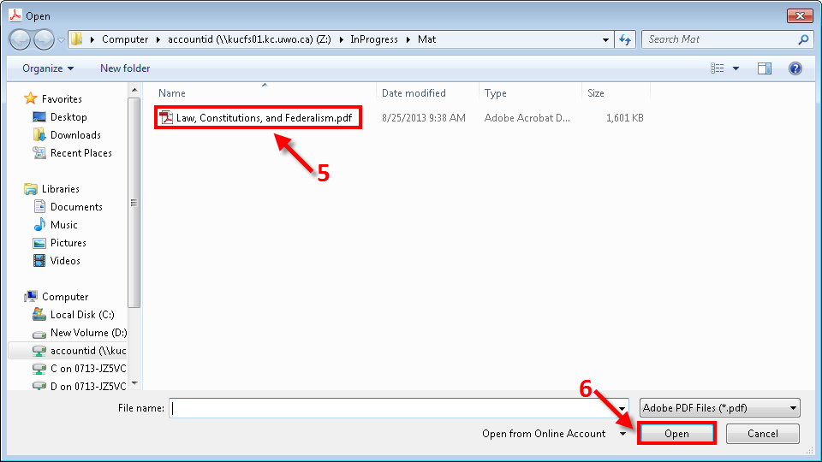
Notes:
You will then want to locate the PDF file which you would like to separate. For this Example, we will be using an electronic PDF book called “Law, Constitution, and Ferderalism.pdf”
5. Click on the file which you would like to use
6. Click Open

Slide 6
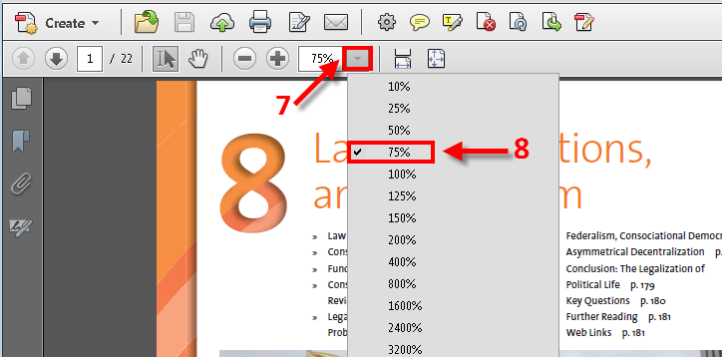
Notes:
Once you have opened the file, you will want to adjust the percentage of the viewed page to 75%.
Note: This is done in order to able to look at an entire page onscreen at one single time.
7. Click on the Downward tab (arrow looking tab)
8. Click on 75%

Slide 7
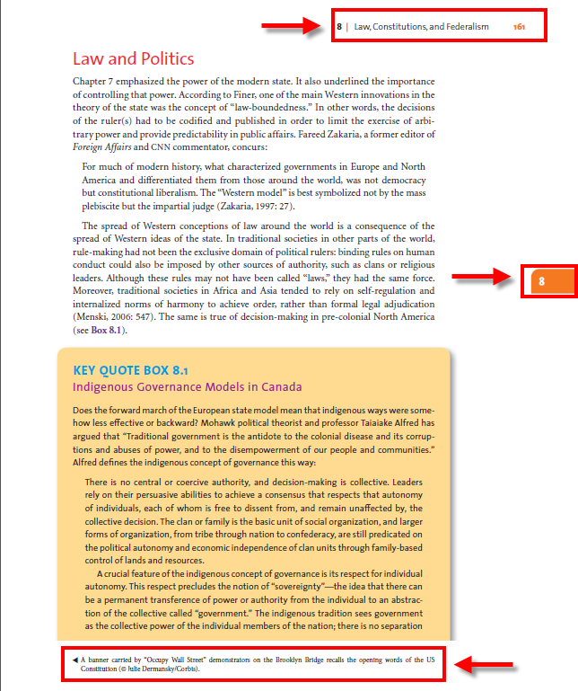
Notes:
This is a page from our separated book. As you may notice, there is a lot of unnecessary page numbers, as well as citations at the top, side and bottom of the page which will need to be cropped out in order for Kurzweil to effectively be able to transcribe and read out the document text.

Slide 8
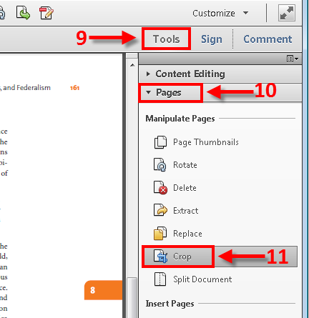
Notes:
To crop the document page, followed the following steps.
Complete the following steps for every individual page in a text book:
9. Click on Tools located near the top right of your Acrobat window
10. Click on Pages
11. Click Crop

Slide 9
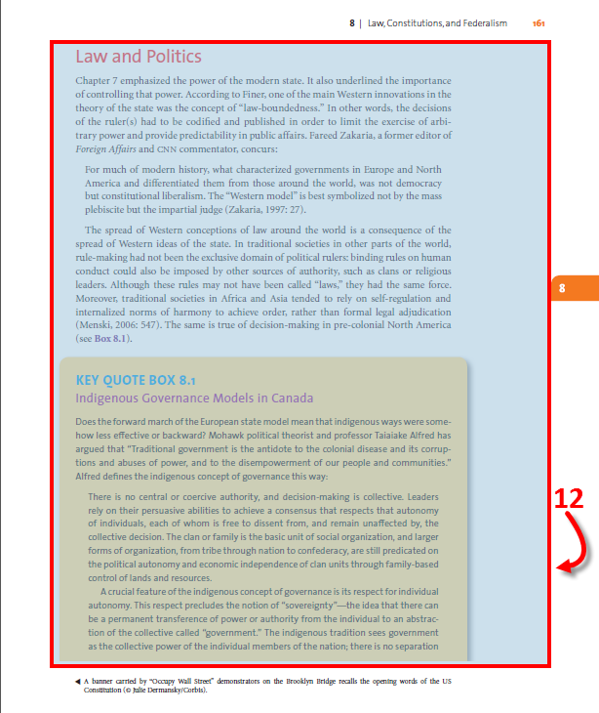
Notes:
12. With your curser (mouse, track pad), Highlight the selection which you would like to keep
Note: everything that is not highlighted blue will be cropped out of the selection
13. In rapid succession, double-click (with the left mouse button) somewhere inside of the box you have just drawn

Slide 10
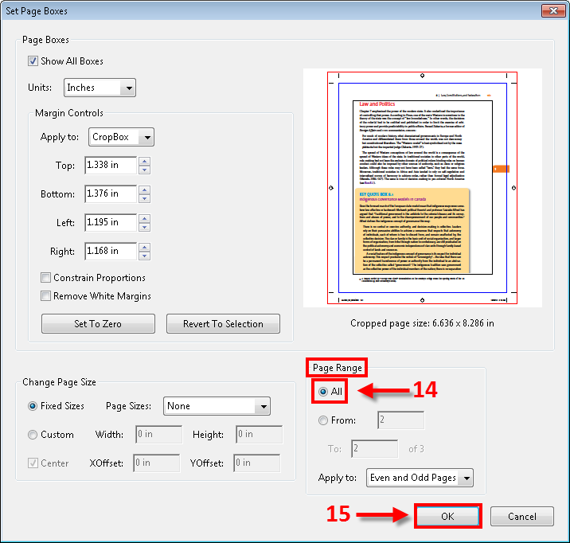
Notes:
The Set Page Boxes pop-up window will appear:
14. Under Page Range, Select All
15. Click OK
Note: if you select All, this will crop all pages in the same spot. If you would like to crop each page separately, please refer to next slide.

Slide 11
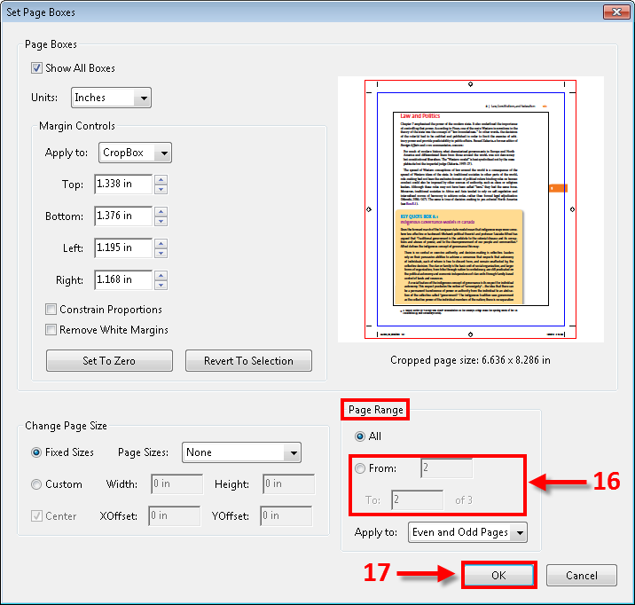
Notes:
14. Under Page Range, Select From. Enter the range of page numbers you wish to crop.
(i.e. From: 1 To: 1 if you wish to only crop that one page OR From: 1 To: 3 if you wish to crop pages 1 through 3)
15. Click OK

Slide 12
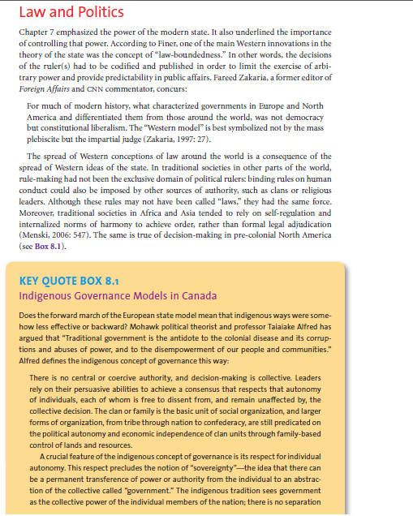
Notes:
The page that was once full of makings and page has been cropped and should now look similar to the image below
Note: All published markings have been cropped off

Slide 13
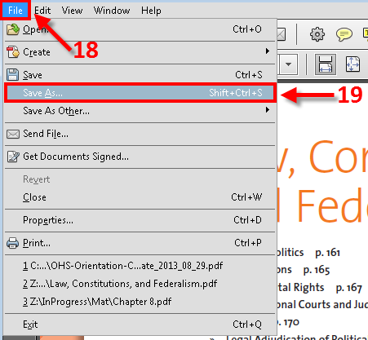
Notes:
You are now ready to save the cropped file.
18. Click on File located at the top left corner of your adobe document window
19. Click Save As…

Slide 14
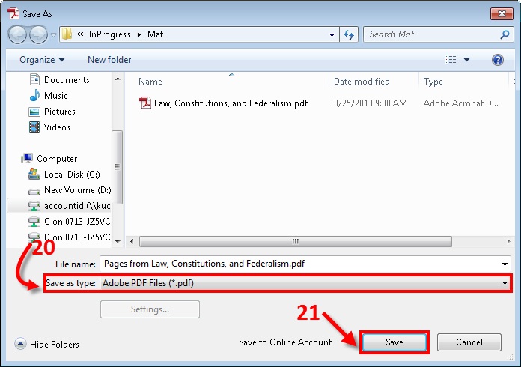
Notes:
20. Ensure that the file type is save as Adobe PDF Files (*.pdf)
21. Click Save
You have now successfully Cropped a Published File.

Slide 15
If you experience any difficulties Cropping Published Files with Acrobat Adobe XI Pro , please don’t hesitate to email the ITS department at:
helpdesk@kings.uwo.ca

