Slide 1
Accessibility fonts, colours,
and hyperlinks
This document will help you create accessibility documents including fonts, colours, and hyperlinks

Slide 2
DON’T use RED, GREEN, or YELLOW mixed with BLUE
Use Black text in titles or for highlighting
Ensure a clear contrast between the text and the background
Notes:
Colours
* Avoid using red or green as well as yellow mixed with blue
* Best to use black text – use colour sparingly and generally in titles or for highlighting
* Conveying a message should not rely solely on the use of colour; neither background nor font
Ensure a clear contrast between the text and images and the background colour or paper colour

Slide 3
Use Non-serif fonts such as Arial and Verdana
Use fonts between 12 and 18 points
Avoid overuse of CAPITAL or italics
Notes:
Fonts
* Non Serif fonts such as Arial and Verdana are good choices
* Use fonts between 12 and 18 points (Note: sizing differs between fonts)
* Avoid overuse of capital letters or italics

Slide 4
Make sure to follow the “ structure of the document “ key points in order to create accessible documents
Notes:
Structure of the document
* Use styles for headings, sub headings and text instead of font attributes
* Avoid the use of watermarks or background designs or images
* Space the lines of a document with at least 25 to 30 per cent of the font size between each
* Columns require less eye movement and peripheral vision than full page documents
* If binding a document use spiral binding or leave large margins to assist the pages in laying flat
* If unable to avoid the use of headers & footers, ensure important information contained there is repeated elsewhere in the document as some
* technologies don’t read headers / footers
* Keep tables as simple as possible and do not use tables to format text into columns
* Avoid hyphenation
* Do not set any security options that prevent access to the document, text, or output methods

Slide 5
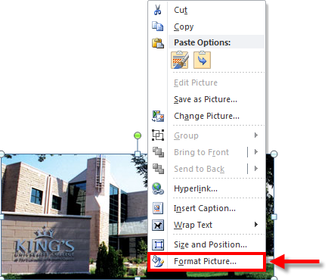
1
Notes:
Provide alternative text for images, through format picture and Alt text
Word documents sometime contain images. These images should be given alternative text (alt text), to be read by screen readers such as JAWS. This alt txt will remain intact if the document is saved as a Word document or a PDF. For more information on this topic, visit out AT Accessibility community and see out wiki on Alt Text Best practices
1. To add alt text to an image, Right-Click on the image and select Format Picture

Slide 6
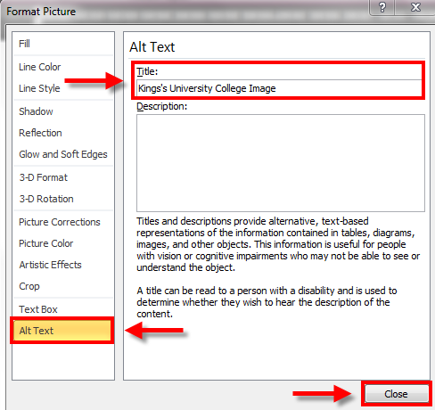
3
2
4
Notes:
2. The Format Picture window will open, select Alt Text tab.
3. Enter the Appropriate Alt Text into the Title Box. Don’t bother to entering a description- that’s not necessary.
4. Then click Close button.

Slide 7
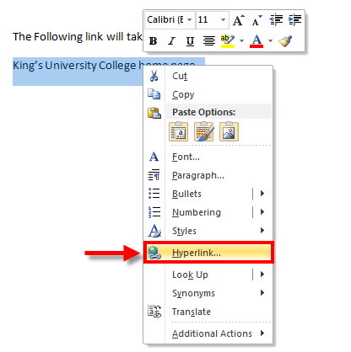
1
Notes:
Add Hyperlinks
In Word, immediately after you type a URL (e.g. http://www.kings.uwo.ca) and press Enter, a hyperlink will be automatically created for you, but this is not always meaningful to an assistive technology user. Whenever possible, make a hyperlink by using a word or phrase within the text that will identify where the link is taking you to. For example, the following link will take you to King’s home page on the web.
To turn a word or a phrase into a hyperlink, use the following steps:
1. Highlight the text you want. Right click your mouse and choose the option “Hyperlink”.

Slide 8
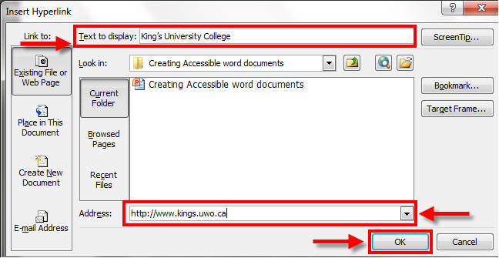

2
3
Notes:
In the window that will pop-up (see image below), the text you highlighted will be displayed in the “text to display” box. Make sure to always provide a description of the hyperlink in plain English using the ‘text to display’ feature in the hyperlink formatting window.
2. You can then type or cut-and-paste the URL address of the page to be linked to the “Address” box.
3. After clicking OK, (you will be able to see an active link (underlines and in blue) as in the example below:

Slide 9
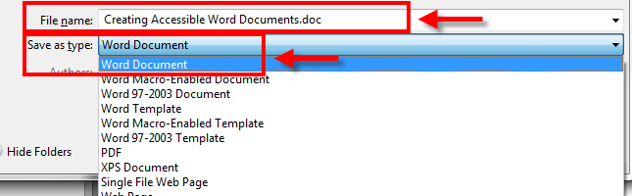
1
Notes:
Accessibility checker
Word 2010 includes an Accessibility Checker that will scan your document for problems. Accessibility checker can only be used on .docx files, and not on the older .doc files.
1. If you have a *.doc file, do a File > Save as Type: Word Document (*.docx).

Slide 10
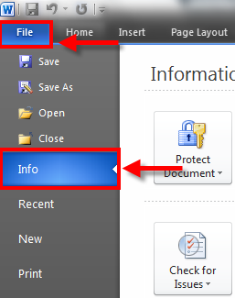
2
3
Notes:
To run the Accessibility Checker:
2. Click on File
3. Then select Info

Slide 11
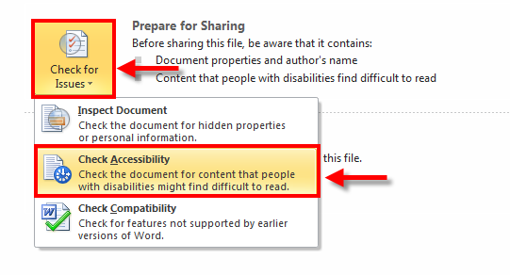
4
5
Notes:
4. Click Check for Issues
5. Select Check Accessibility

Slide 12
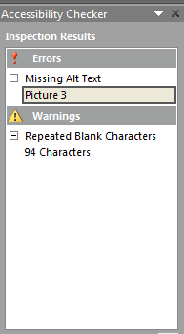
Notes:
Accessibility Checker will report accessibility problems in your document, give you an opportunity to fix them before you publish.

Slide 13
If you still can’t create accessibility documents including fonts, colours, and hyperlinks please don’t hesitate to email the ITS department at:
helpdesk@kings.uwo.ca

